Slide 1
Winds of change
Varandas, Bruno
Owens Corning
August 22

Slide 2

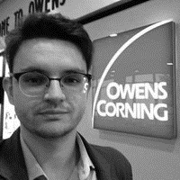
BRUNO VARANDAS
Gerente Comercial Américas, e Gerente de contas Wind Global
Owens Corning
+ Administrador de Empresas pela universidade de Sorocaba
+ MBA em Negócios Internacionais pela ESAMC
+ Pós Graduando em materiais polímeros e compósitos pelo IPT
+ Mais de 18 anos de experiência em Energia Eólica

Slide 3
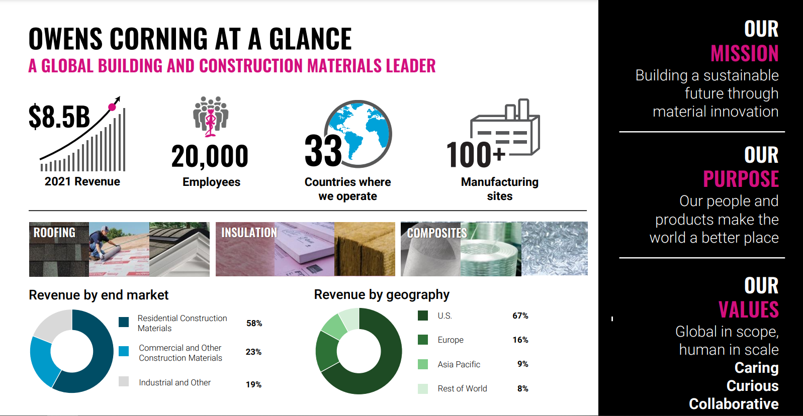

Slide 4
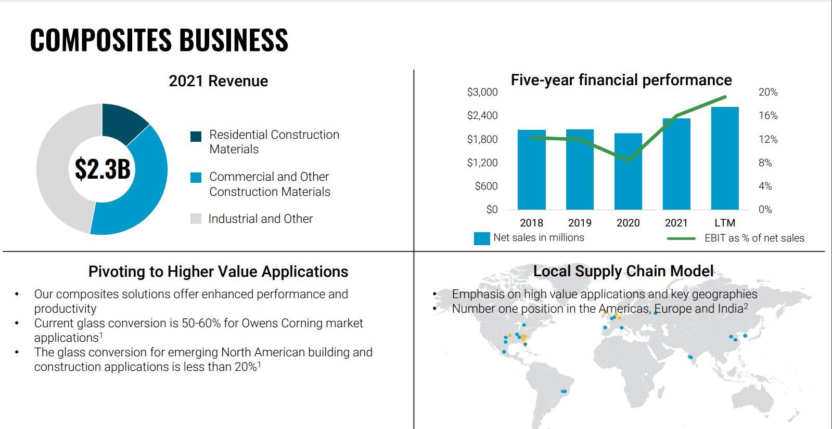

Slide 5
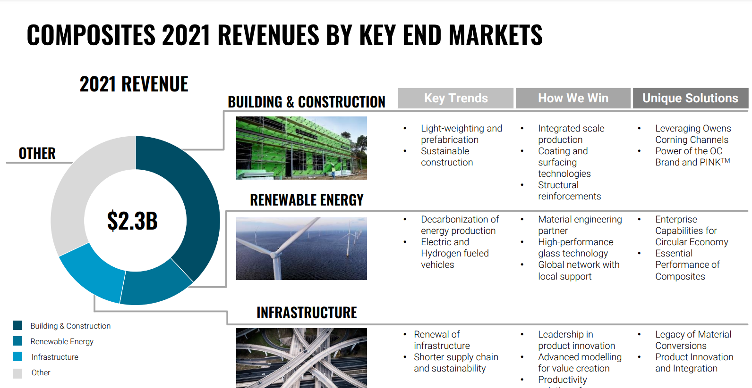

Slide 6
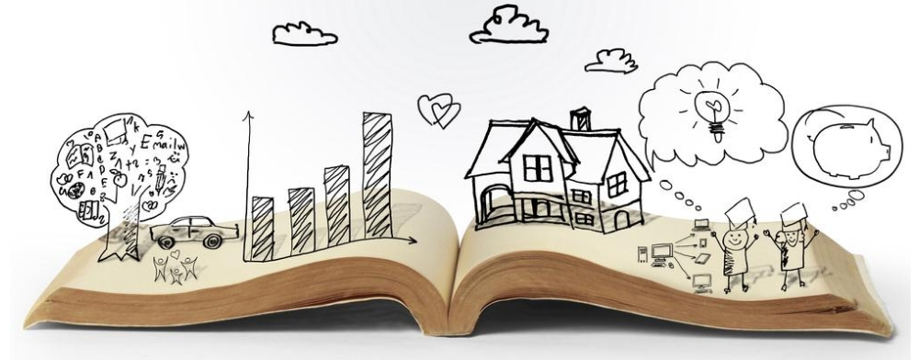
What nice story we have created so far

Slide 7
Wind Market is growing
Total Installed Capacity (GW) vs Fabrics Consumption
Brazilian Electric Matrix
186
GW
US$ 36 bi invested between 2011 and 2021
28.8Million of households per month can be supplier – 86.4Million of benefited inhabitants
Between 2011 and 2020, wind power moved R$ 321Billion in economy – R$ 111Billion on direct investments
21.2Million tons of CO2 avoided in 2021
Brazil has become again, a very important hub of exporting wind blades (30% in 2021)
Brazil will have about 37GW of wind power installed capacity until 2026
Offshore is coming – first projects expected to start on 2027
FONTE: Abeeólica

Slide 8

Future?
Is not something we enter, the future is something we create

Slide 9
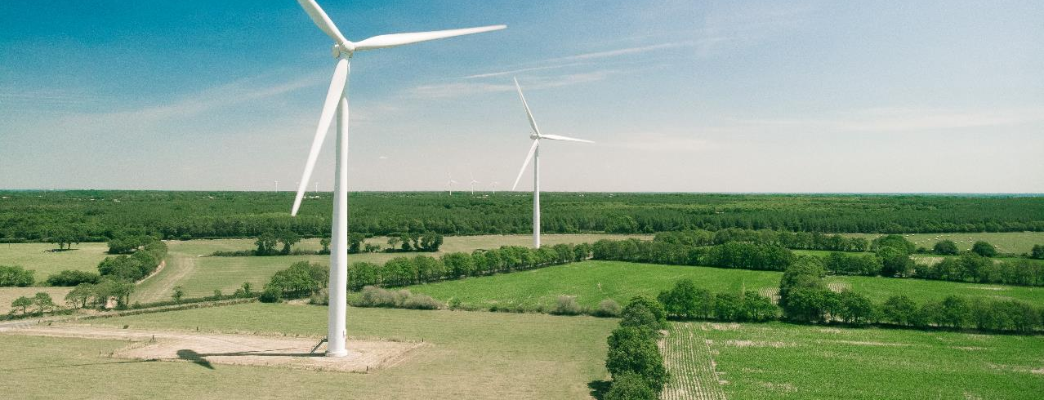



LONGER BLADES
Redefining higher modulus
LOWER CYCLE TIME
Driving customer productivity
GREENER
Sustainability at our core
As the world and climate change, so do we – together, as partners we adapt to deliver a material difference in the world.
Together we make the impossible, possible: lighter, stronger, more-durable, more cost-effective.
This is HOW WE POWER THE FUTURE of sustainable energy.
OWENS CORNING WIND
MATERIALS ENGINEERING PARTNER
TO DESIGN & BUILD BETTER BLADES

Slide 10
Owens Corning wind focus areas
PARTNERING TO POWER LONGER, STRONGER, & LIGHTER BLADES
Glass: H² + H³ GLASS
Hybrid: ULTRABLADE ® X (25-57%)
Carbon: ULTRABLADE® C
Pultruded plank for spar caps: ULTRASPAR™
Glass: WINDSTRAND®
Fabric: ULTRABLADE®
OC® KITS & PREFORMS:
  Standard kits
  Stitched preforms
Preshaped blade parts: ULTRASHAPE™
PET foam core materials: WINDCORE®
Designing for recyclability: ZEBRA
Reducing GHG: Wind LCA analysis
Eliminating waste: potential opportunity with downstream integration
Addressing existing blades: exploring recycling technologies
LONGER BLADES
Redefining
Higher modulus
LOWER CYCLE TIME
Driving customer productivity
GREENER
Sustainability
at our core
OWENS CORNING WIND
MATERIALS ENGINEERING PARTNER
TO DESIGN & BUILD BETTER BLADES
DESIGN
At the blade designers’ table to make the impossible possible
BUILD
Industrializing and optimizing new designs/products globally
+

Slide 11
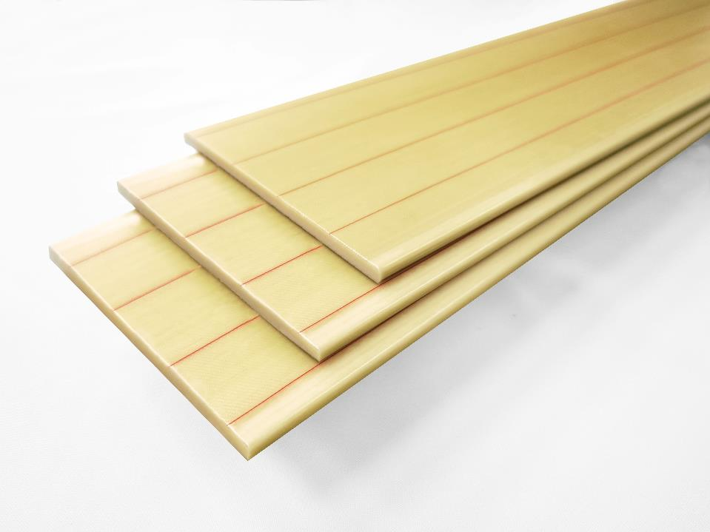
Redefining higher modulus & materials science
NEW GLASSES, NOVEL FABRICS CAPABILITIES, AND INNOVATIVE TECHNOLOGIES
¹Performance | Standard glass |  | Higher-modulus glass |  | Hybrid | Carbon
Glass (GPa) | ADVANTEX® | H-GLASS | H² GLASS | H³ GLASS | GLASS + CARBON HYBRID | PURE CARBON
Glass single filament sonic modulus | 82 | 89 | 91 | 95+ | - | -
Fabric (GPa) | ADVANTEX® FABRICS | ULTRABLADE® | ULTRABLADE® 2 | ULTRABLADE® 3 | ULTRABLADE® X | ULTRABLADE® C
Laminate modulus T0º (@ 55% FVF) | 42-44 | 48 | 51 | 54+ | 62 / 71 / 92 | ~120
Pultruded plank (GPa) | - | ULTRASPAR™ | ULTRASPAR™ 2 | ULTRASPAR™ 3 | ULTRASPAR™ X | ULTRASPAR™ C
Laminate modulus T0º (@ 70% FVF) | - | 59 | 63 | 67+ | Evaluating | Evaluating
OWENS CORNING WIND
HOW WE
POWER LIGHTER, LONGER BLADES
Redefining higher modulus
& materials science
Creators of the first viable glass fiber product and high-modulus glass for wind blades
Continuous investment in R&D to invent new materials and technologies
A materials engineering partner to design + build better blades
Introducing ULTRASPAR™ – pultruded planks that maximize the performance of H, H² and H³ glass
¹Performance properties may vary upon sales region and manufacturing site.

Slide 12
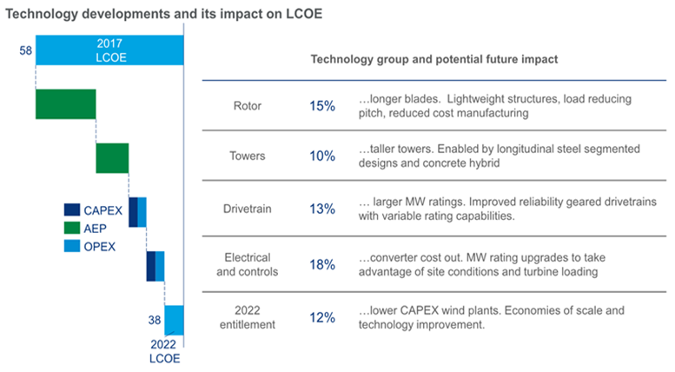
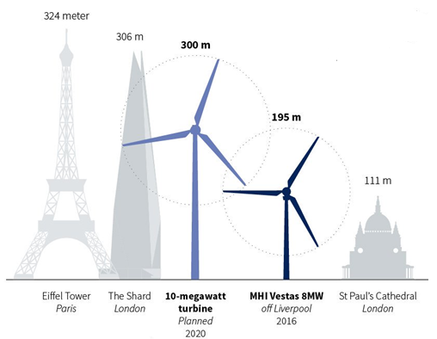
New technologies and lcoe impacts
BLADE TECHNOLOGY IS KEY IN BENDING THE CURVE OF FURTHER LCOE REDUCTION. TECHNOLOGICAL ADVANCEMENTS PROVIDE LCOE REDUCTIONS OF UPTO 35% BY 2022 WITH BLADE TECHNOLOGY HAVING A MAJOR IMPACT ON AEP
New glass technologies are giving the designers the chance of developing longer and lighter blades

Slide 13
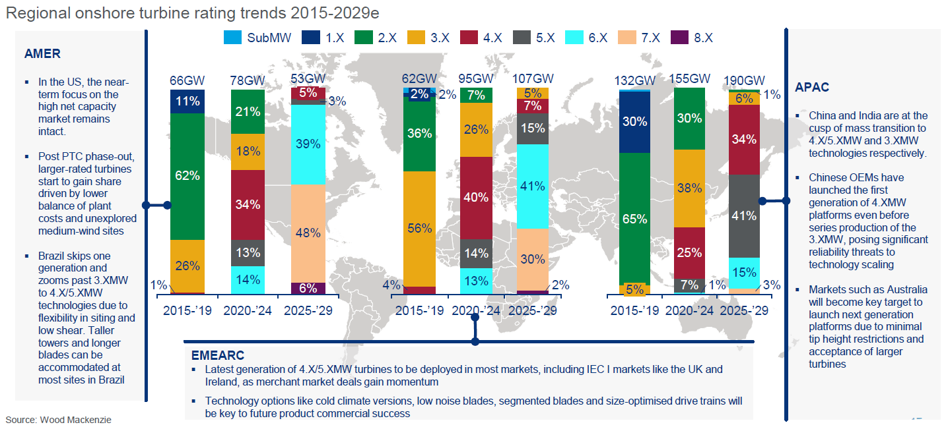
New technologies and lcoe impacts

Slide 14

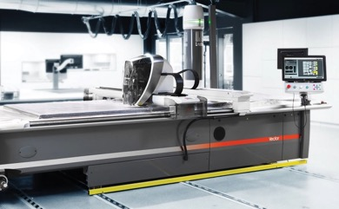
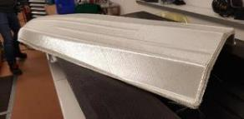

Blade making productivity
LOCAL SUPPLY CHAINS, CUSTOMIZED SUPPORT, and POWERING UP THE NEXT LEVEL OF PRODUCTIVITY
OWENS CORNING WIND
HOW WE
POWER LOWER CYCLE TIMES
OC® Kits & Preforms¹
Standard kit cutting at-scale in China
Preform capabilities in China & India
Additional capabilities added to R&D
and…
ULTRASHAPE™ (+) functionalization to preforms
Innovation in powder binder combinations layers / functionalization of the fabric (2D)
Development of shape-able fabrics technology enabling production of 3D preforms for productivity
Driving blade making productivity to build better
Glass and fabrics production in every major blade making region
Kits & Preforms solutions
Added f to preforms through
¹
+
=
GLOBAL
ALLIANCE
Developing technologies and processes for productivity

Slide 15
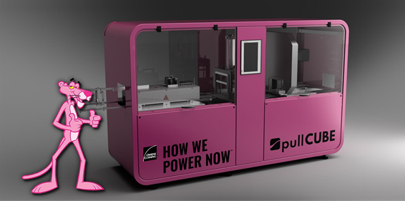
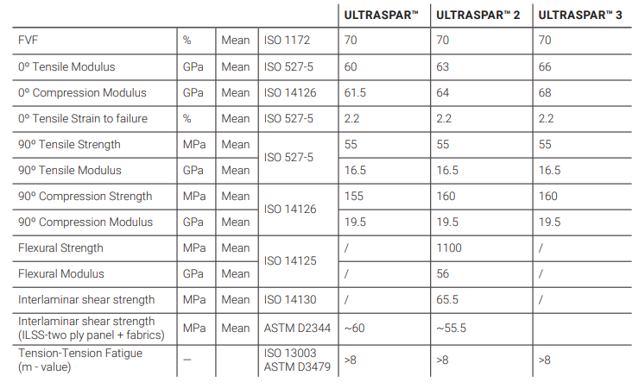
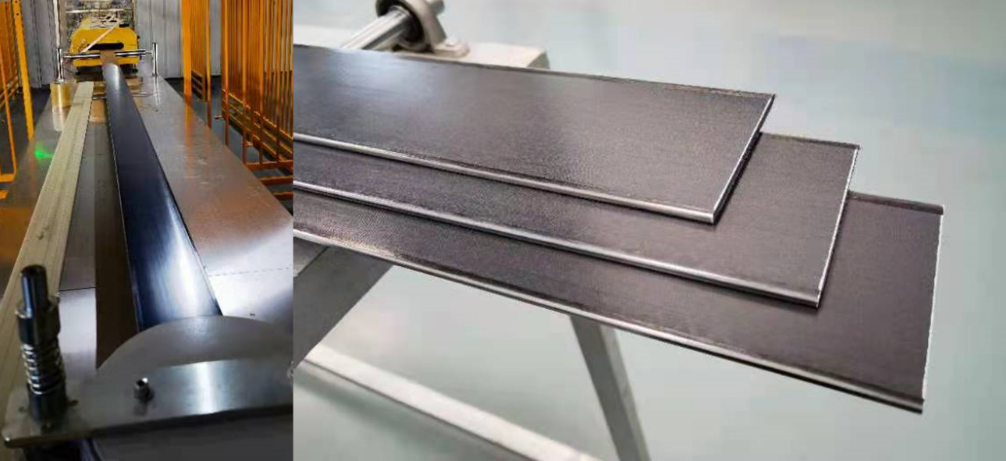
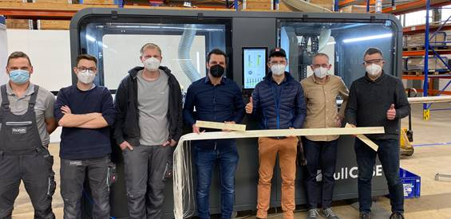
ULTRASPAR

Slide 16
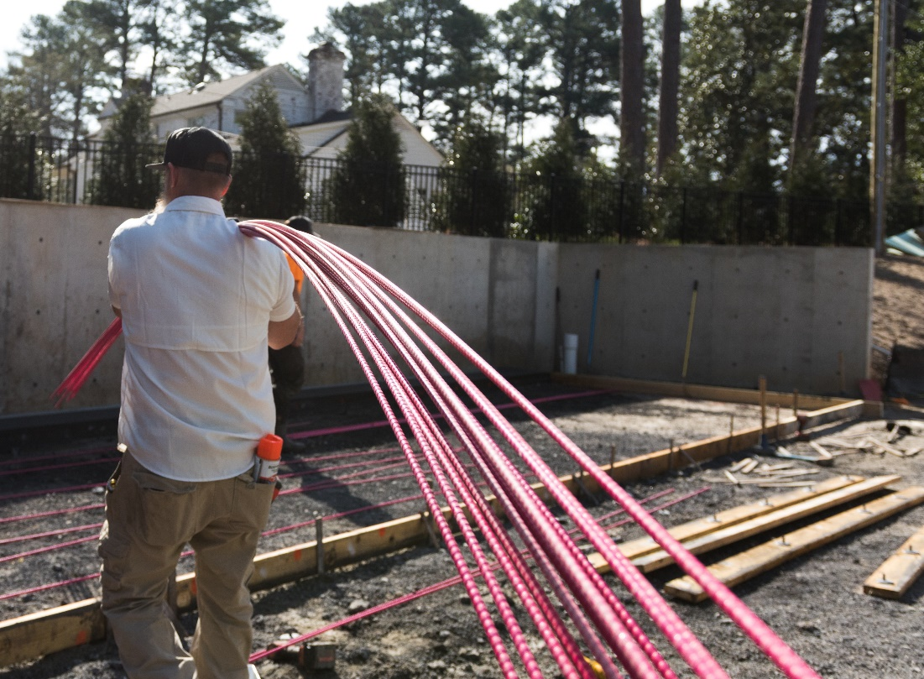
Fiberglas™ rebar
KEY-BENEFITS
+ PRODUCTIVITY
+ DURABILITY
+ SAFETY
STRONGER
LIGHTER
2x tensile strength
4-7x lighter
NONCONDUCTIVE
MORE DURABLE
Electrical isolator
Thermal insulator
Corrosion free
Notes:
Significant Production Gains
Half the man hours means half the time to perform.
Same number of jobs, less reliance on a large labor force.
Better quality from my core group

Slide 17
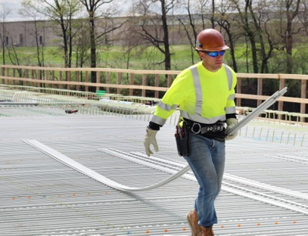
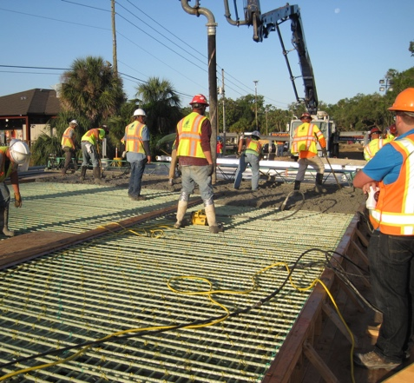
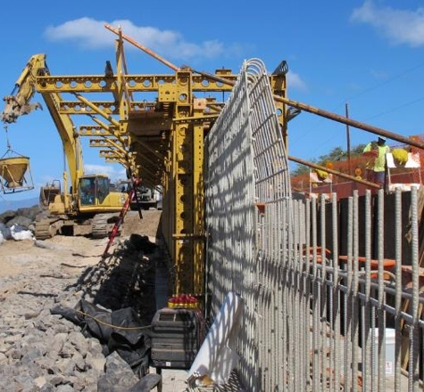

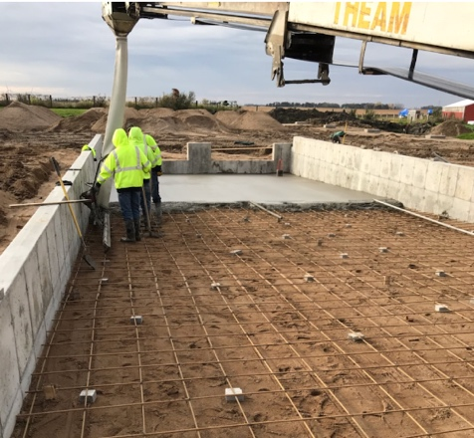
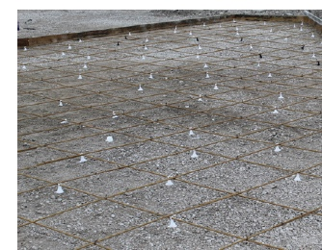
Fiberglas™ REBAR
PRODUCTS DESIGNED FOR STRUCTURAL, RESIDENTIAL AND COMMERCIAL APPLICATIONS
MATEENBAR™ FIBERGLAS™ REBAR
Structural applications
High-performance, structural, lightweight, corrosion free concrete reinforcement
Bridge Decks
Sea Walls
PINKBAR® FIBERGLAS™ REBAR
Residential & Commercial applications
Smarter solution for more productive job-sites and more durable slab-on-ground applications
Agricultural Pads
Driveways

Slide 18
Sustainability at our core
Leading the industry to tackle the challenges we face
Green house gas emission reduction
Reducing the carbon impact of OC’s wind products
Leveraging local supply chains when available and exploring transportation efficiencies
OC Wind + Sustainability
OC is a recognized industry leader in sustainability and recently launched our 3rd set of sustainability goals for 2030.
Included in these goals by 2030:
Reduce absolute green house gas emissions by HALF
Switch to 100% renewable electricity
Send zero waste to landfill
OWENS CORNING WIND
HOW WE
POWER GREENER BLADES
Double the positive impact of our PRODUCTS
Full-chain waste reduction
Reducing waste throughout the full value chain from blade making to:
  OC® Kits & Preforms + ULTRASHAPE™
  Fabrics
  Glass making
Sustainability at our core
Halve the negative impact of our OPERATIONS
Proven track-record of continuous progress with ever ambitious targets
Going to the next-level through wind-specific initiatives to help our customers achieve their commitments
Beyond a supplier… a materials engineering partner to design and build better blades
Designing for the future
Materials to enable a fully recyclable blade
Strategically optimizing the amount of high CO₂ intense materials (i.e. CF) through new concepts
Leveraging higher modulus glasses versus E-glass to reduce amount of materials needed in a blade

Slide 19



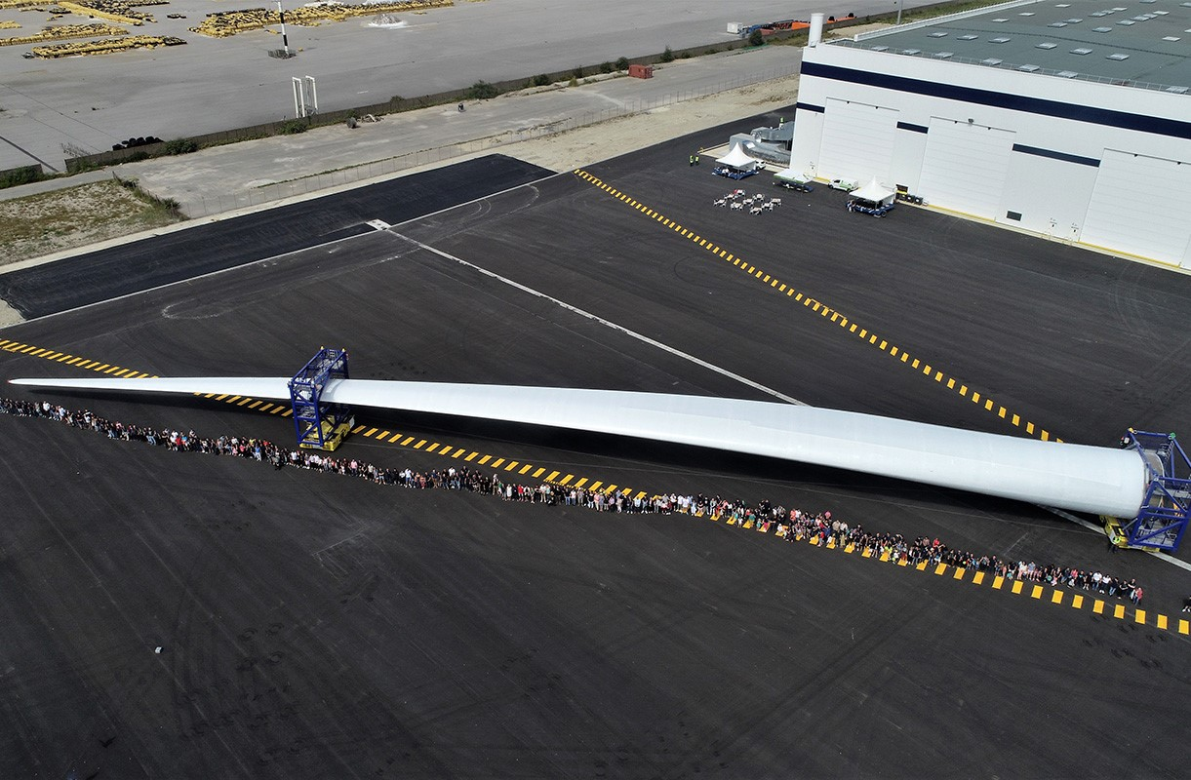



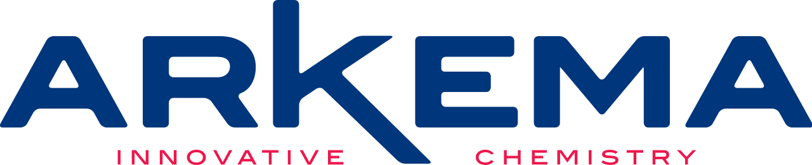


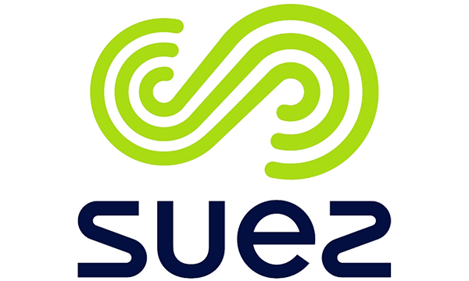
100%
RENEWABLE
ELECTRICITY
100%
recyclable
blade
Owens Corning
~$2 billion
of our roofing & insulation fiberglas™ products sales are 100% Wind Power certified
~60%
of our electricity source is renewable in the U.S alone
In partnership with:
Owens Corning Wind
100%
of our electricity source is renewable in Zele, Belgium
(plant & wind lab)
100%
of our electricity source is renewable in
San Vicente, Spain
(plant)
… and we are not done yet.

Slide 20
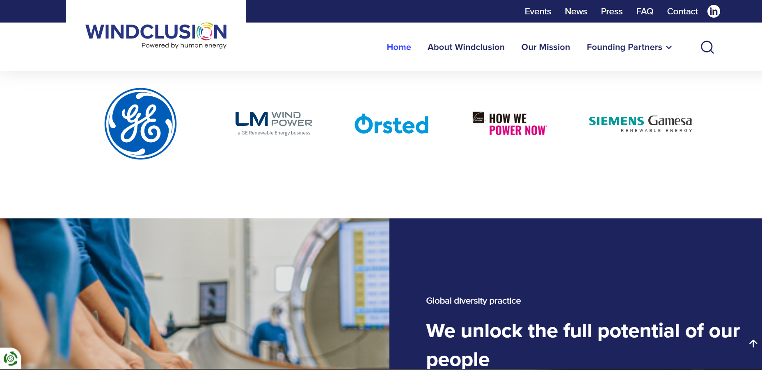

Slide 21
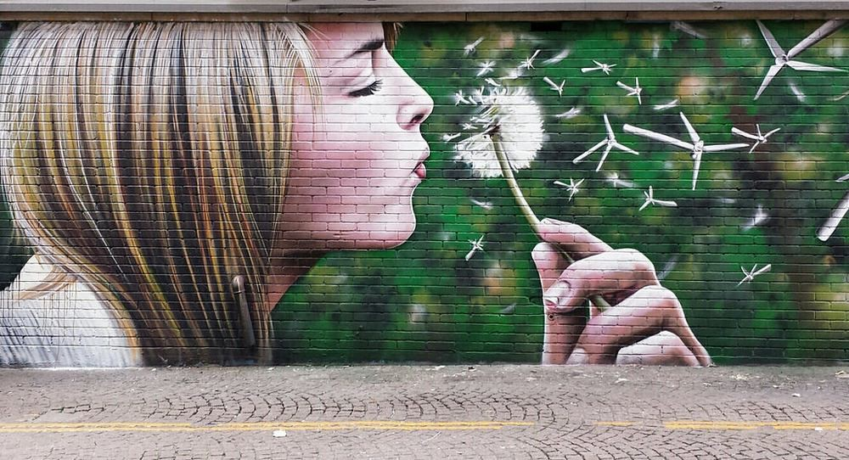

Q&A

