Slide 1


Values brought by latest ArmaPET foams innovation
Feiplar 2022
Stefan Reuterlöv

Slide 2





ABOUT ARMACELL ARMAPET PRODUCTS
SURFACE TREATMENT (ST) of PET FOAM CORE
ARMAPET ECO PRODUCT
HIGH DENSITY (HD) PET FOAM SOLUTIONS

Slide 3

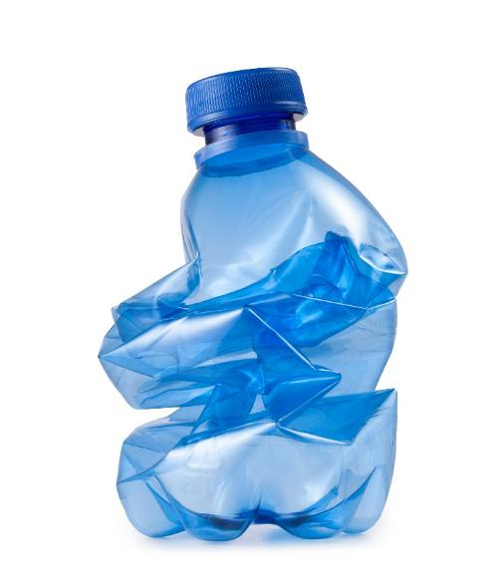
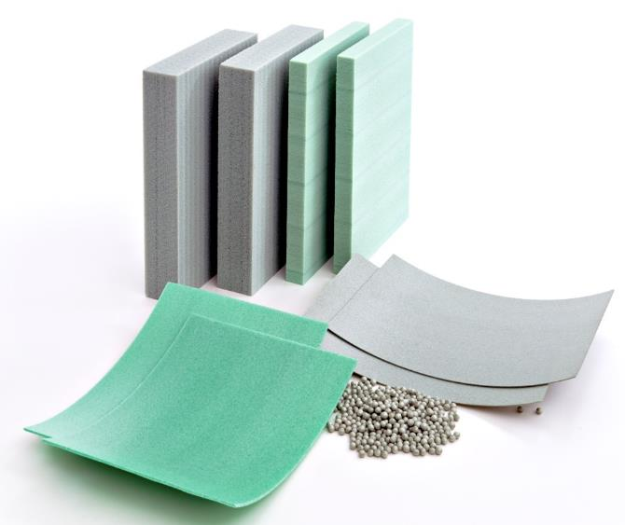



// PET Foams at a glance
Sustainable product solutions based on 100% post-consumer PET
Patented recycling technologies with lowest ecological footprint
Sustainable product solutions that enhance efficiency throughout the manufacturing process and elevate the life cycle performance of composite sandwich structures
Notes:
Global presence:
BELGIUM / Thimister
PET Foams headquarters with global R&D centre / Sales & Marketing
CANADA / Brampton
CHINA / Suzhou

Slide 4

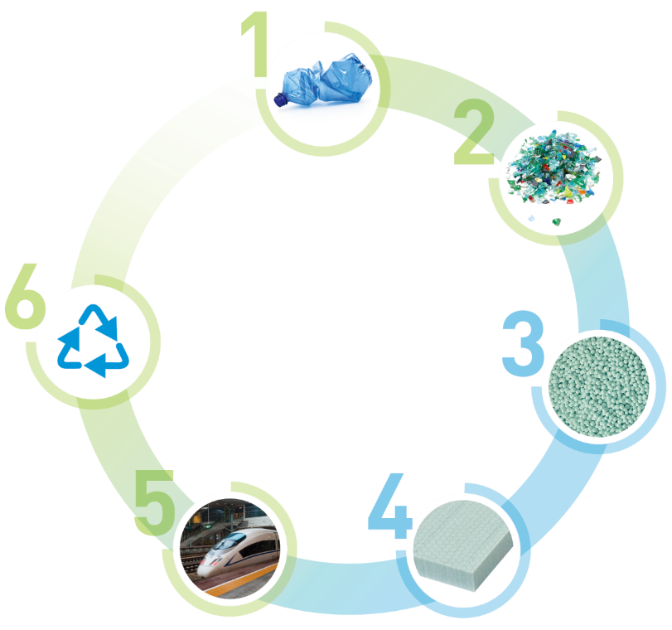



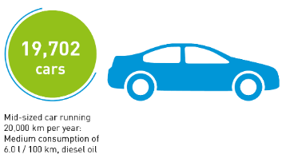
// From Bottle to Foam
Patented rPET processing technology
savings of
90,432
metric tonnes
2,000,000,000
RECYCLED BOTTLES
RE-USED

Slide 5
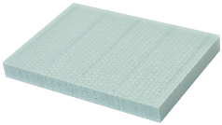
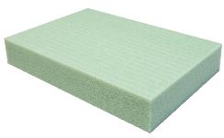
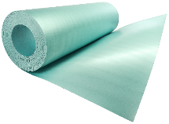
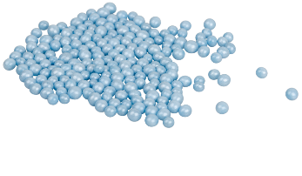
// ARMAPET PRODUCT SOLUTIONS
We offer sustainable product solutions that enhance efficiency throughout the manufacturing process and elevate the life cycle performance of your composite structure.
ArmaPET Struct
ArmaPET Eco
ArmaPET Curve
ArmaPET Shape
ArmaPET Struct is the versatile and durable solution for structural sandwich applications, with a more environmentally responsible approach.
ArmaPET Eco combines insulation and structural integrity, ensuring energy and emission efficiency for decades of use.
ArmaPET Curve is designed for recyclable thermo-formable micro sandwich solutions produced in continuous manufacturing processes.
ArmaPET Shape particle foam offers maximum design flexibility to produce lightweight rigid 3D foam parts using innovative fusion technology.

Slide 6
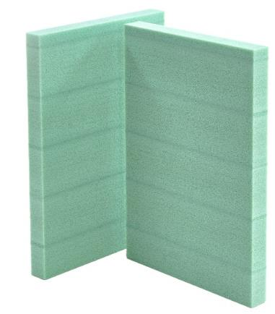
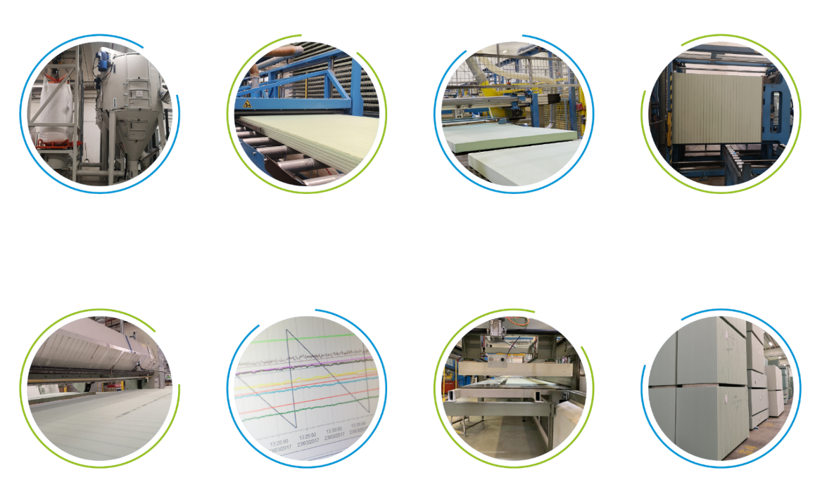








// ArmaPET® Struct manufacturing process
Main steps
GRANULATION
EXTRUSION
CUTTING
BLOCK WELDING
COMPLETE MONITORING
FOR 100% RELIABILITY
Raw material inspection
100% inline density control
Unique barcode per board
Every board is digitised
SLICING
QUALITY INSPECTION
SQUARING
PALLETISING

Slide 7
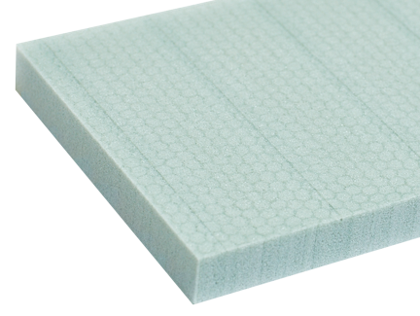
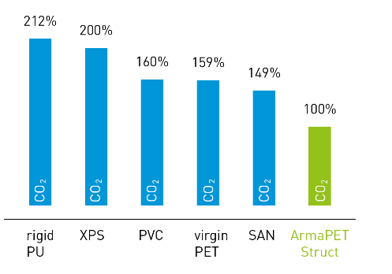
// ARMAPET STRUCT
Structural foam core
// Proven and reliable performance since 2010
// Minimal fluctuation in product properties
increases process stability
// Excellent thermal and dimensional stability
facilitates repeatability in production
// Outstanding fatigue resistance bolsters
long-term performance and low lifetime
maintenance
// 100% recycled material supports industry
environmental and sustainability directives
// Full range availability anywhere and at any
time
POSITIVE ECOBALANCE:
SUSTAINABLE PRODUCT SOLUTIONS FOR LIGHTWEIGHT COST-EFFECTIVE COMPOSITES STRUCTURES
CO₂ emission of ArmaPET Struct in comparison to competitive materials. ArmaPET = 100% reference

Slide 8
ABOUT ARMACELL ARMAPET PRODUCTS
SURFACE TREATMENT (ST) of PET FOAM CORE
ARMAPET ECO PRODUCT
HIGH DENSITY (HD) PET FOAM SOLUTIONS

Slide 9
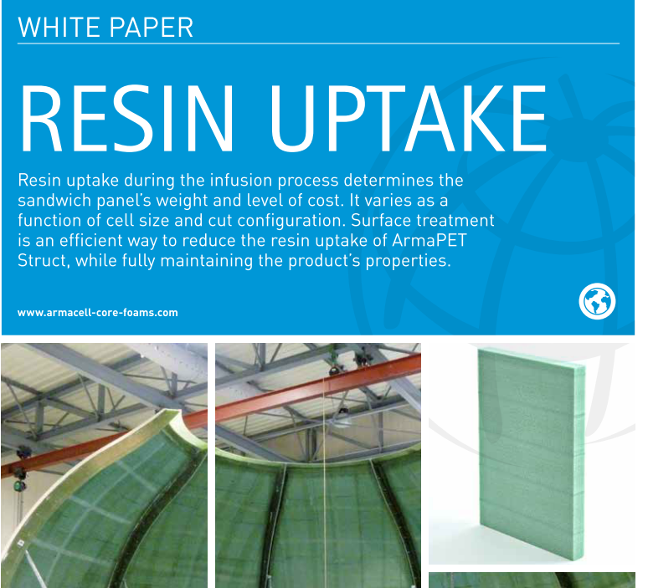
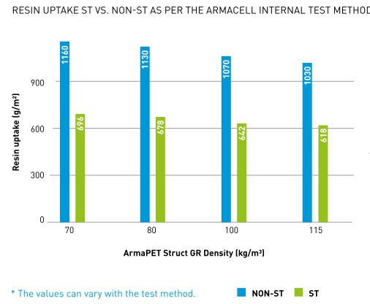
Surface treatment
Lowering Resin Uptake is one influencing factor for more lightweight structure, allowing our customers to use less resources.
Surface Treatment is now implemented as standard [for our low and medium densities GR 70-150] to generate resin consumption savings (30-40%) for our customers, without compromising on mechanical performance or peel adhesion.
For details on Resin Uptake and Surface Treatment, please consult our updated White Paper [and datasheet]:

Slide 10
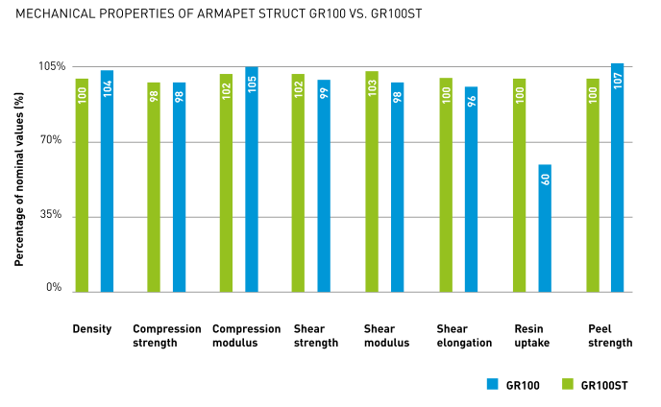
Surface treatment
Test result with and without the surface treatment is presented in comparison with the datasheet properties for GR 100 (100 kg/m3 density).
Surface treatment is most effective for low density, thick plain sheet material.
Higher density, lower thickness and especially converting (grooves, slits and perforations) will lower the relative efficiency of the process.

Slide 11
ABOUT ARMACELL ARMAPET PRODUCTS
SURFACE TREATMENT (ST) of PET FOAM CORE
ARMAPET ECO PRODUCT
HIGH DENSITY (HD) PET FOAM SOLUTIONS

Slide 12
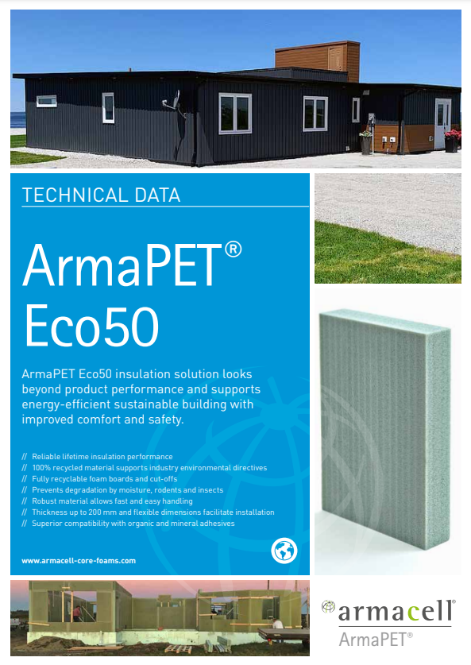
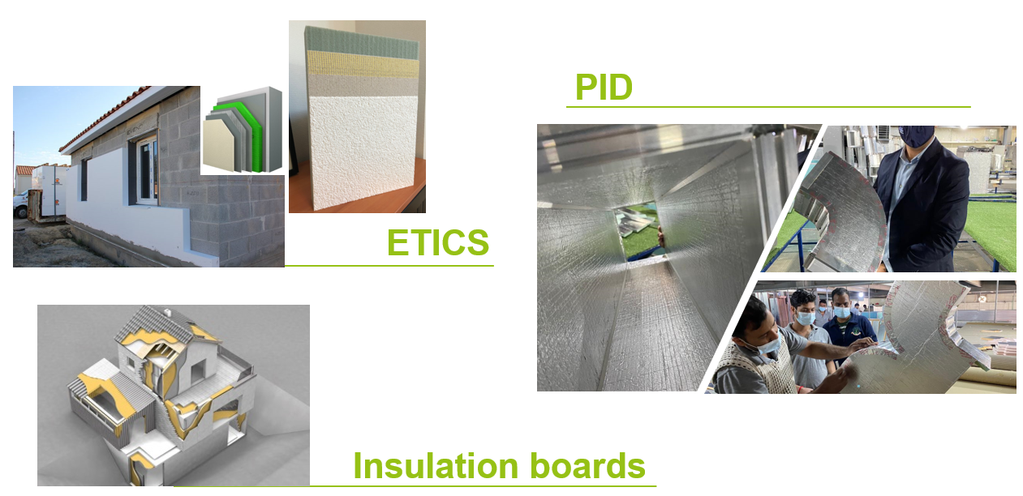
// ArmaPET Eco range
Our innovative (semi-)structural thermal insulation solution for applications in B&C (new buildings and building renovation) based on 100% rPET:
Building envelopes
(Flat) Roofs
Floors
Internal partitions

Slide 13
// ArmaPET Eco
Value Proposition
ArmaPET Eco insulation solution looks beyond product performance and supports energy efficient sustainable building with improved comfort and safety
Reliable lifetime insulation performance
100% recycled material supports industry environmental directives
Fully recyclable foam boards and cut-offs
Prevents degradation by moisture, rodents and insects
Robust material allows fast and easy handling
Thickness up to 200mm and flexible dimensions facilitate installation
Superior compatibility with organic and mineralic adhesives
CE-Certified
EPD available
λ <0,03 at 10°C

Slide 14
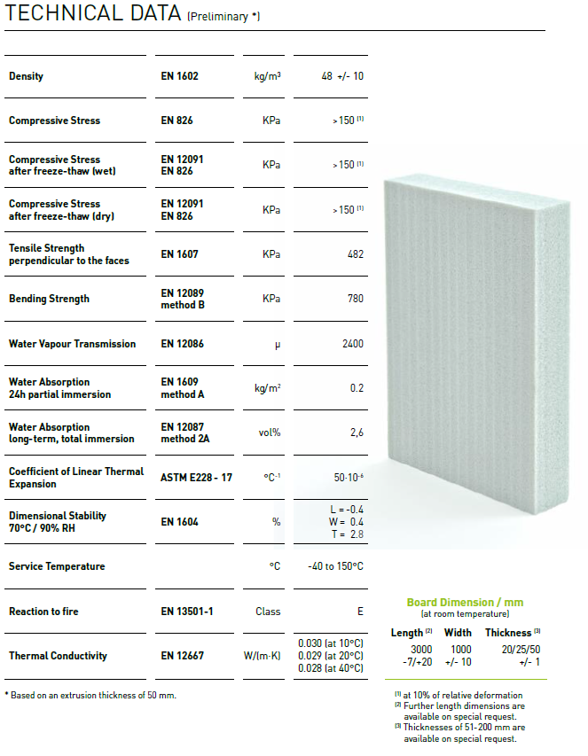
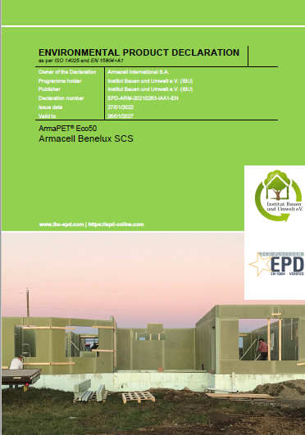
// ArmaPET Eco50
B&C tailored specification
First PET foam board tailored for B&C insulation applications, replacing EPS/XPS and PU insulation
EAD 040179-00-1201, from March 2016, «Factory-made products of extruded, foamed Polyethylene terephthalate (PET) for thermal and/or acoustical insulation» was developed with KIWA
ETA for Eco50 under preparation (final testing ready end of May)
First Armacell PET product with EPD
Application instructions under creation

Slide 15
// ArmaPET Eco50
Insulation Performance
Low water absorption and stability ensures long-term insulation performance of ArmaPET Eco50
Other foams like PUR/PIR degrade quickly in insulation applications due to moisture ingress.

Slide 16
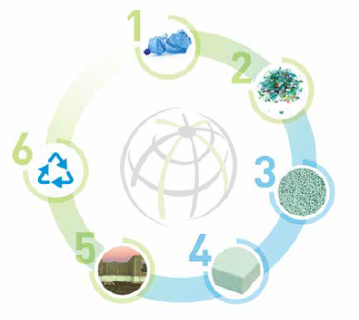
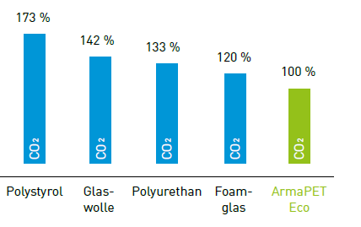
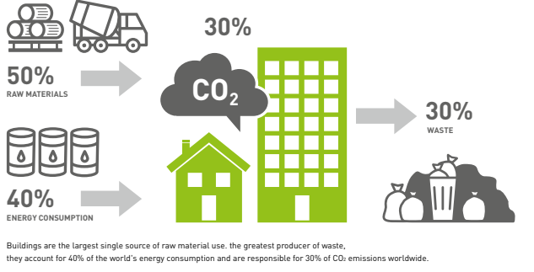
// ArmaPET Eco Range
Sustainability
Based on 100% recycled PET
100% recyclable
No HFC’s / CFC’s
Compliant VoC levels for indoor emission
Low CO2 footprint supports European Green Deal and sustainable building requirements

Slide 17
ABOUT ARMACELL ARMAPET PRODUCTS
SURFACE TREATMENT (ST) of PET FOAM CORE
ARMAPET ECO 50 PRODUCT
HIGH DENSITY (HD) PET FOAM SOLUTIONS

Slide 18
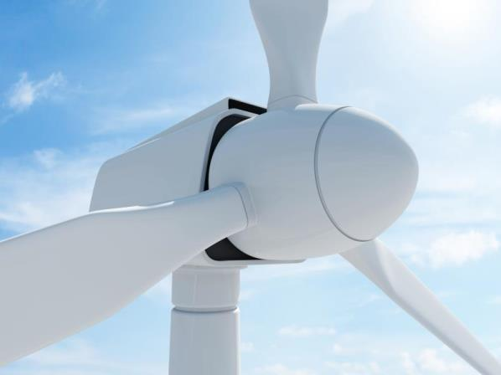
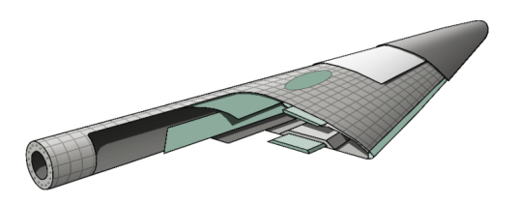
// WIND ENERGY
Rotor blades, Nacelles, Spinners
Over 150,000 wind turbine blades globally cored with ArmaPET Struct core (onshore / offshore) today.
PET foam core has in the past 10+ years substituted PVC and SAN cores in wind energy blade applications however the Balsa core shares remained untouched until recently.
Balsa was seen as a very competitive material in regards to the strength to weight ratio and hence used in application where PET Foams would never be specified.
But all wood products have the same inherited drawbacks when it come to variation in properties and moisture uptake – degradation resulting in swelling and then loss of properties.
Quality control and qualification – large scatter in properties
LCC difficult to access – increased need for repairs
Logistic situation with natural grown product.
9

Slide 19
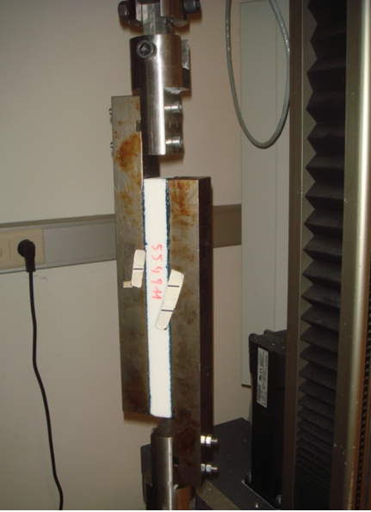
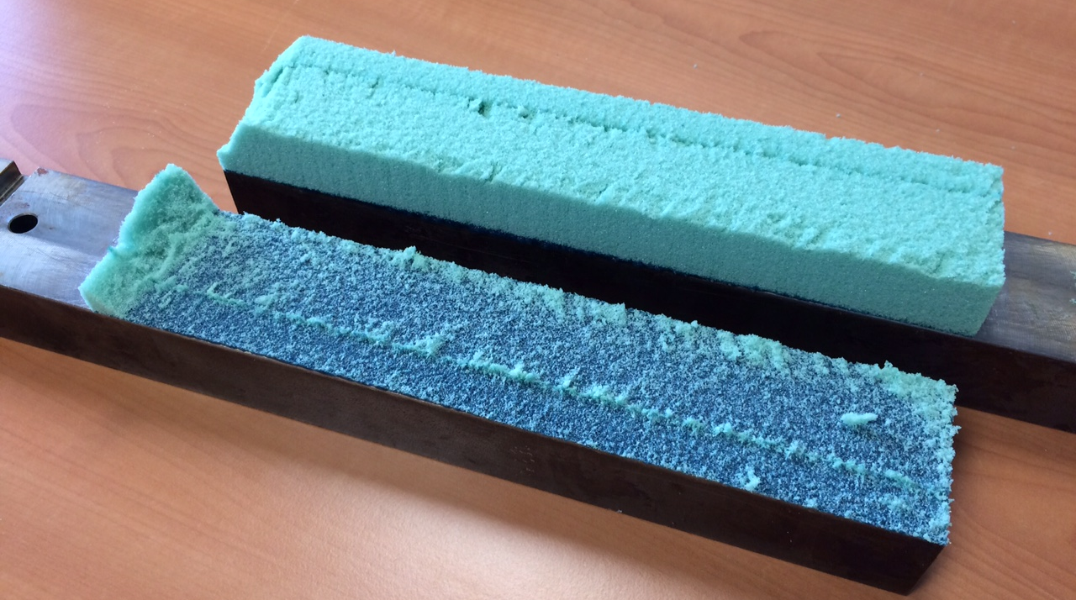
// HIGH DENSITY PET
Balsa has fantastic properties on paper.
Typical datasheet shear strength for medium density end grain balsa of 155 kg/m3
EGB 155 3.0 MPa
ArmaPET Struct GR 250 2.0 MPa
But testing in 4-Point Bending show something else. 4-Point Bending is a more realistic testing method using the full sandwich part.
Note: The ds properties for ArmaForm GR250 are still conservative and the shear strength can be expected to increase from 2.0 MPa to around 2.5 MPa.

Slide 20
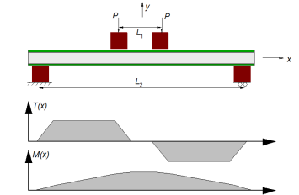
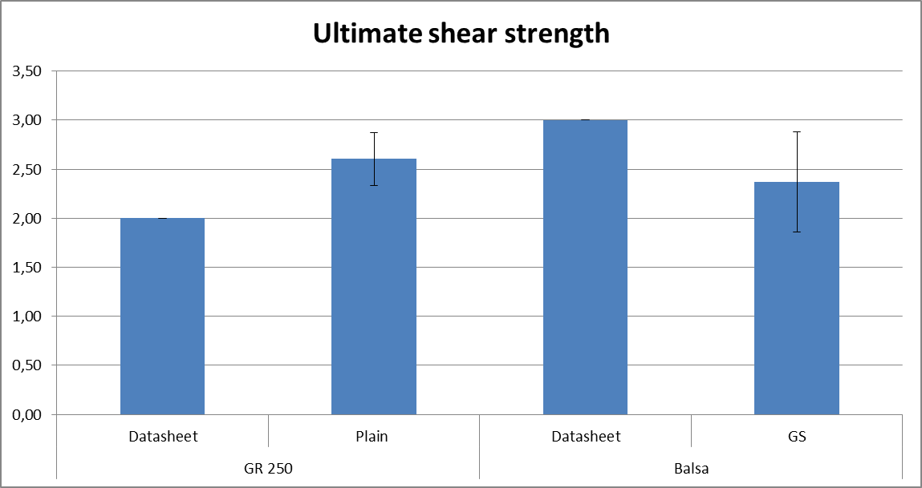
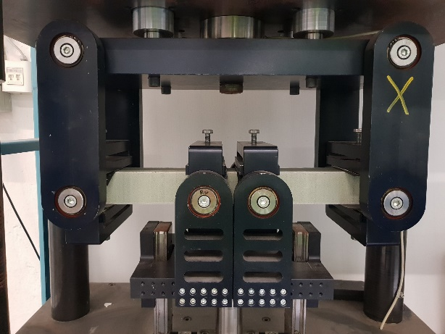
// HIGH DENSITY PET
Balsa has fantastic properties on paper but testing in 4-Point Bending show something else. ArmaPET Struct GR250 has clearly higher shear strength when tested in 4-Point Bending than
balsa beams (50 mm thickness).
Note: The ds properties for ArmaPET Struct GR250 are still conservative and the shear
strength can be expected to increase from 2.0 MPa to around 2.5 MPa.
Four-point bending test rig

Slide 21

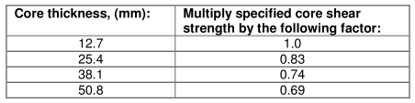
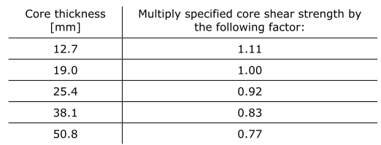
// HIGH DENSITY PET
Why do we see such difference in performance?
Balsa is normally tested in shear on ½ inch specimens. Due to thickness effects similar to honeycomb all material that is thicker will also be weaker.
For example two of the main Balsa producers list a reduction of 23% and 31% going from ½ inch to 2 inch.
The 4-point beam testing showed a reduction of 21% compared to datasheet so in line.
The higher results for PET core has been verified with modified block shear specimen configuration with results > 2.6 MPa.

Slide 22
// HIGH DENSITY PET
ArmaPET Struct GR250 has clearly higher shear strength when tested in 4-Point Bending than Balsa beams.
But we still have the higher density/weight of the PET Core??
Results comparing listed datasheet and 4-point bending shear strength for ArmaPET Struct GR250 and EGB 155 respectively

Slide 23
// HIGH DENSITY PET RESIN UPTAKE
fatigue treshold
> 60%
Resin uptake is density dependent.
Resin uptake proportional
to ArmaPET Struct GR100:
Especially compared with end-grain balsa,
the difference in uptake will make significant
savings in weight and cost.
ArmaForm vs. end-grain Balsa:
ArmaPET Struct GR250
5 kg/m² + 0,6 kg/m² resin = 5,6 kg/m² 21 €/m²
Balsa155
3 kg/m² + 3,8 kg/m² resin = 6,8 kg/m² 15 €/m²
ArmaPET Struct GR250:
saving in WEIGHT of 1,2 kg/m²
savings in COST of 5,2 €/m²
Note: Cost of resin 3,5 €/kg

Slide 24

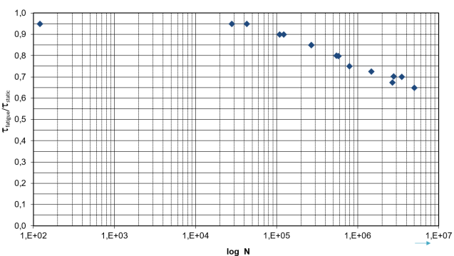
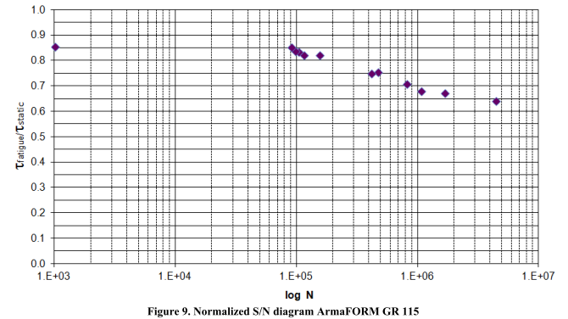
// HIGH DENSITY PET
Fatigue testing on ArmaPET Struct GR200 at KTH
ArmaPET Struct GR200:
ArmaPET Struct GR115:
Broad service temperature range:
-40 to +180 °C
-38 to +356 °F
Correlation between ArmaPET Struct GR200 and previous testing on ArmaPET Struct GR115 and other grades are extremly close and again confirm that results are density independant if normalised.
The fatigue threshold level is >60% and GR grade easily exceed the DNV GL requirement on m>10, for ArmaPET Struct GR115 m=16,9 and testing on ArmaPET Struct GR200 indicate at least this number.

Slide 25
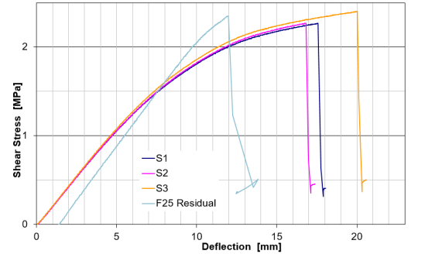
// Fatigue testing on GR 200 at KTH
Static testing show after 5 million cycles at 65% loading
no degradation of strenght or stiffness for ArmaPET Struct GR200.

Slide 26
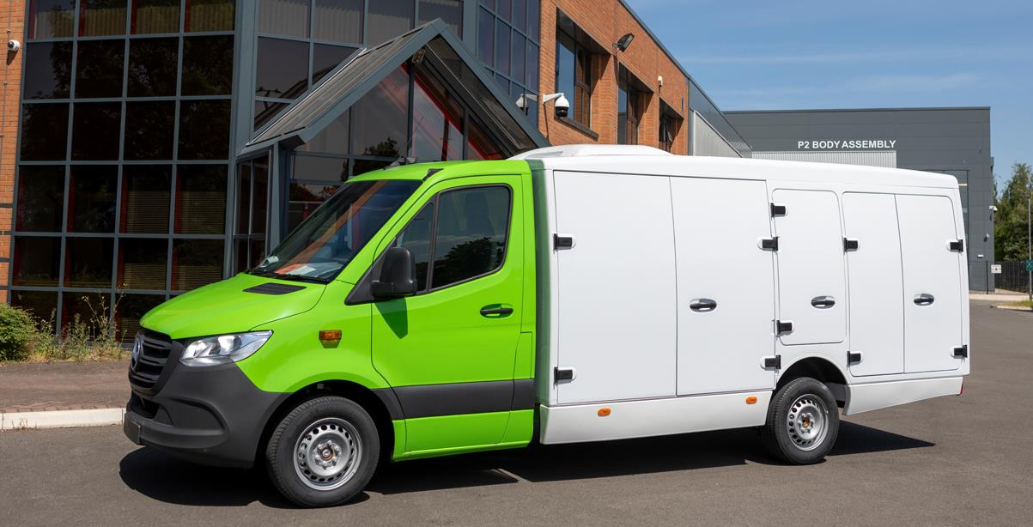
Body Structure
Penso’s Blue Ocean Home Delivery Pods are made of ArmaPET Struct.

Slide 27
// CASE STUDY: PENSO TRUCKS
Thermplastic core based sandwich to optimize transport efficiency
Efficiency
Sustainability
Durability
Profitability – total cost of ownership
Safety and Security
EFFICIENCY
Weight reduction - Extra cargo load
Fuel savings → £2,400 per vehicle/year
Aerodynamic optimisation
SUSTAINABILITY
Reducing CO2 emissions → 6.3 tons per vehicle/year
Recycling of Core + Skin:
Carbon recycling using pyrolisation process
PET Core can be re-granulated and recycled
PROFITABILITY
Optimized Payload (33%) and operating efficienty
Fleet Savings
Reduced Total Cost of Ownership by £6,700
per vehicle/year
SAFETY & SECURITY
Design optimized for fewer accidents, better access and safe operations
DURABILITY
Equivalent material tested on train door:
  Core passes 1 Mio durability cycles and pressure testing with loads up to 7000N
All structural load-cases proven for 10 year warranty and 1250 kg payload
Easy repair
Notes:
More deliveries per load
• Stem mileage reduction
• Reduction in fuel costs
• Reduction in labour costs
• More efficient CapEx utilisation
• Reduced vehicle emissions
e-Grocery Pod delivers 2,500kg payload x 2 delivery cycles
• Benchmark product delivers 2,500kg payload x 3 delivery cycles
• Payload improvement improves delivery efficiency x 33%

Slide 28
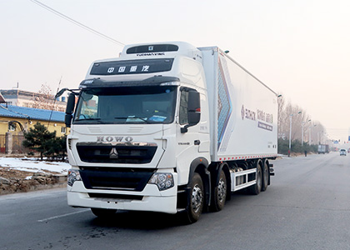
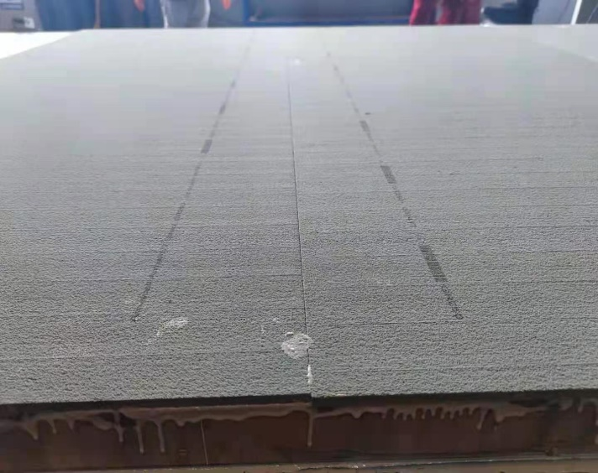
// Refrigeration truck
Refrigeration truck manufacturer in China
Floor: GR250 + FRP skins
GR250 replaces plywood
  Weight reduction: 4kg/m2
  Lower water absorption
  Higher screw retention
Note: Green is for screw anchor and blue for screw only

Slide 29

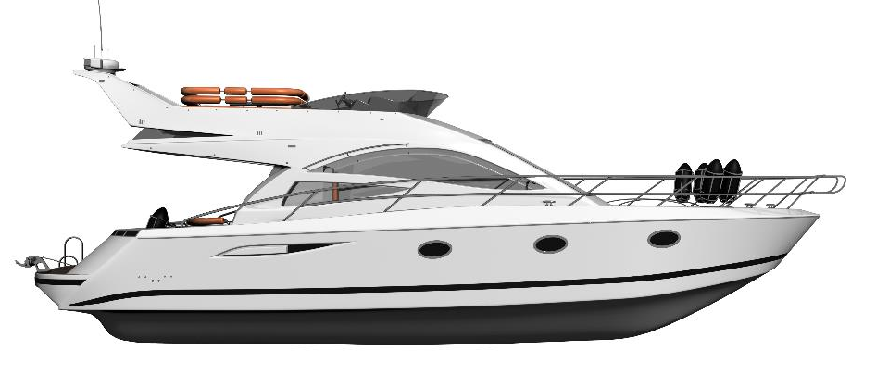
// ArmaPET Struct applications
NON STRUCTURAL PARTS / LOCAL REINFORCEMENT in plywood
Designer drivers: shear stiffness / compression stiffness / density
Applications:
Transom / Hard Spots
Core density depends in boat size.
Typical for 40 ft boat: 200 kg/m³
These can preferably be replaced by high density ArmaPET Struct GR 200/250 to avoid fatigue and moisture related problems during the life span of the yacht.
Notes:
Stringer: Longitudinal internal member to add stiffness.
Hull: The watertight body of a boat.
Bulkhead: The transverse wall within the hull.
Freeboard: The minimum vertical distance from the surface of the water to the gunwale.
Gunwale: The upper edge of a boat's sides.

Slide 30

Sports Equipment
ArmaPET is used in racing windsurf boards, SUP blades or skis.
.
.

Slide 31

// SUMMARY HIGH DENSITY PET VS. EGB
Advantages for ArmaPET Struct cores vs. End-grain Balsa core materials etc.
No moisture sensitivity
Excellent fatigue properties exceeding those of EGB
Much lower density variation and flat sheets
Excellent processing stabilty
Possiblity to recycle the core, scrap from kitting today and the rest after the end of the blade life cycle
A core solely based on recycled PET material, improves LCA
Lower weight after infusion
Lower produced cost
And better shear strength and ductility

Slide 32
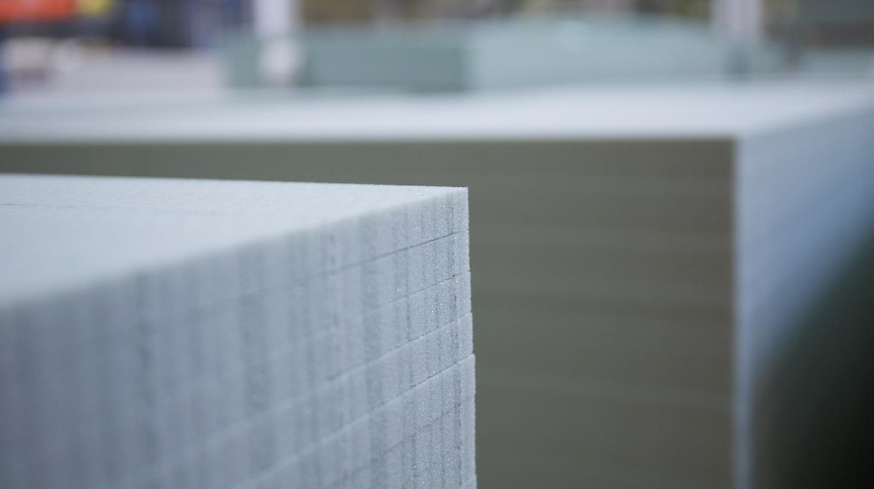
Q&A
Thank you
STEFAN.REUTERLOV@ARMACELL.COM

